Slide 1
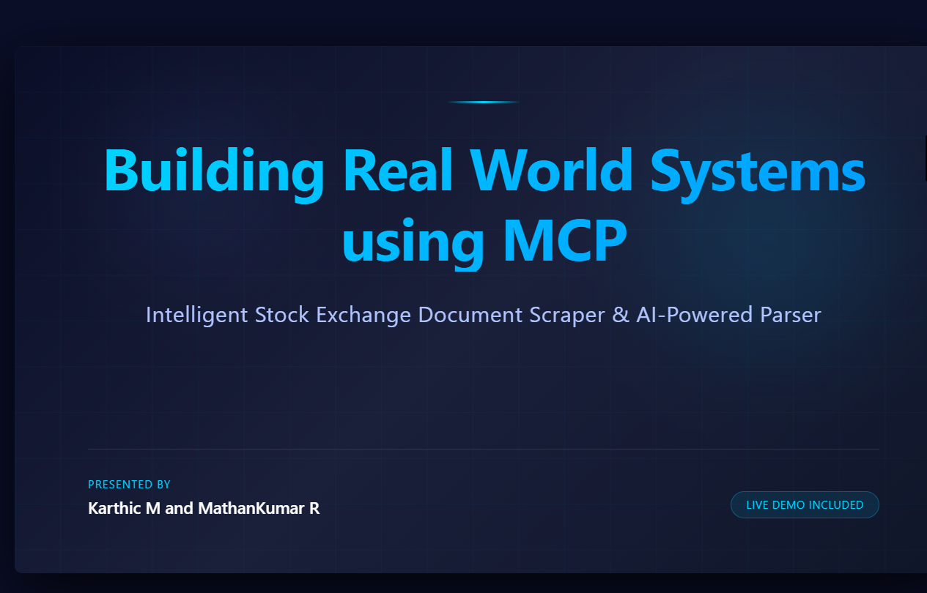

Slide 2
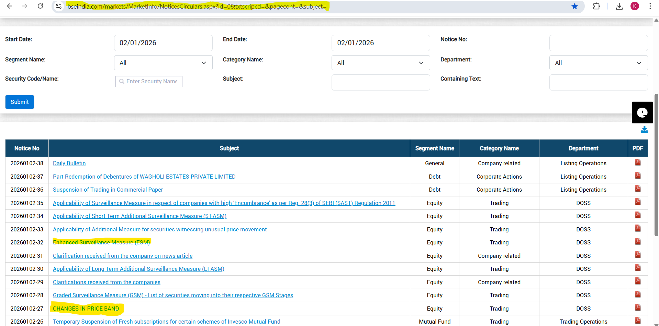

Slide 3
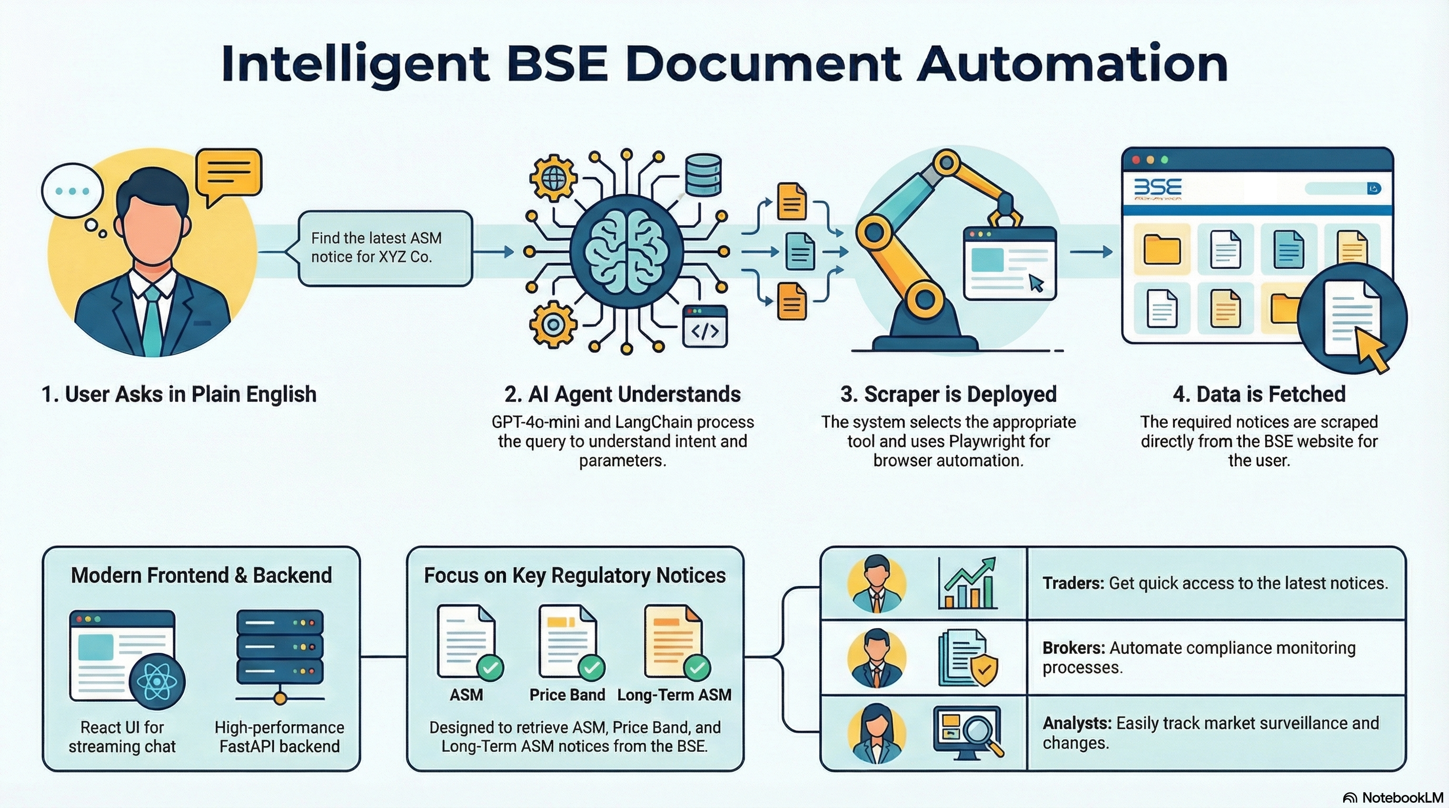

Slide 4
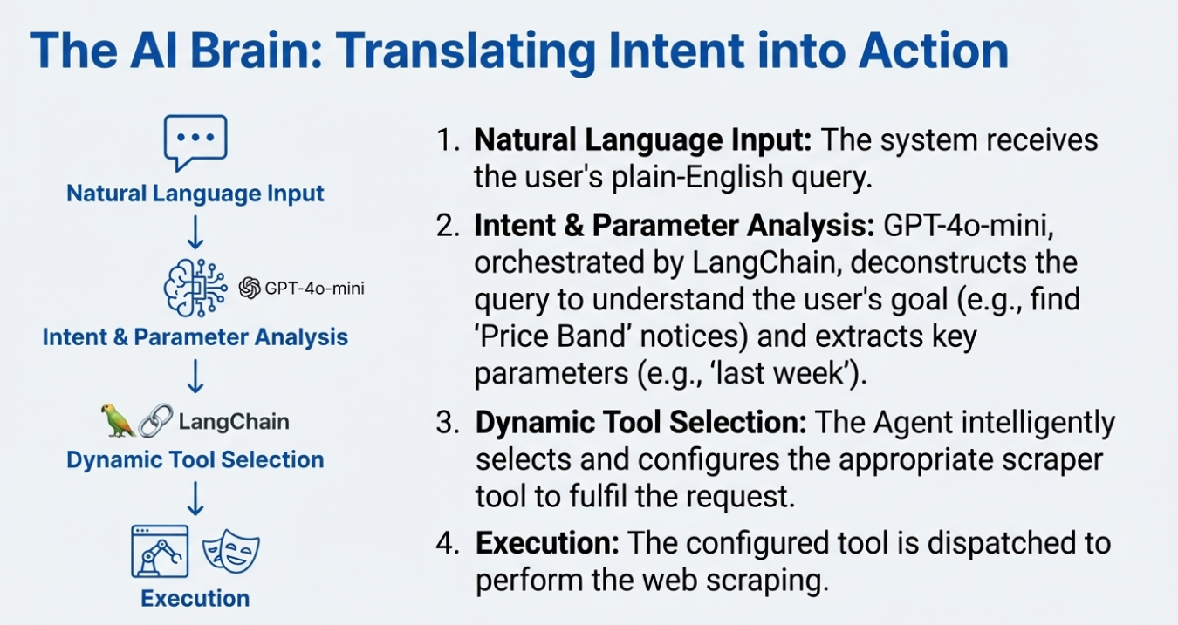

Slide 5
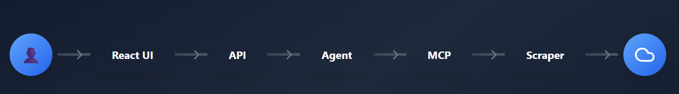
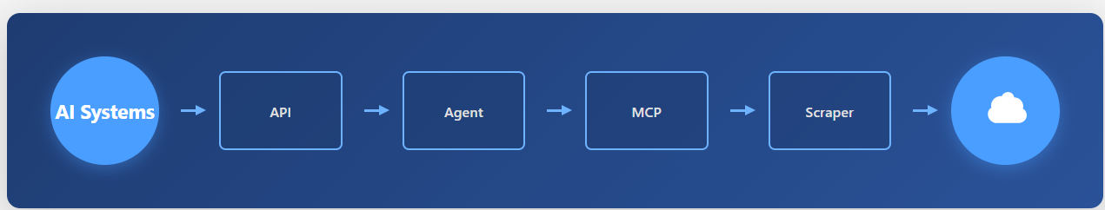
System Architecture
Using Web Application
Using LLM
🖥️ Frontend
🔌 API
🧠 AI Agent
🕷️ Scraper
React + TypeScript + Material-UI (Vite)
FastAPI + Python backend
LangChain + OpenAI (GPT-4o-mini)
Playwright + Regex pattern matching

Slide 6
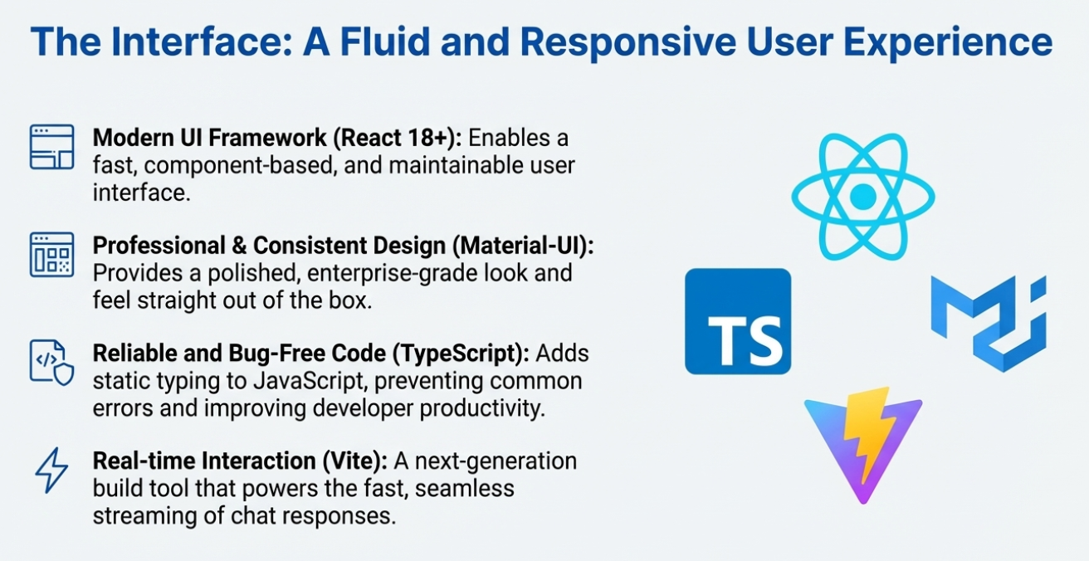

Slide 7
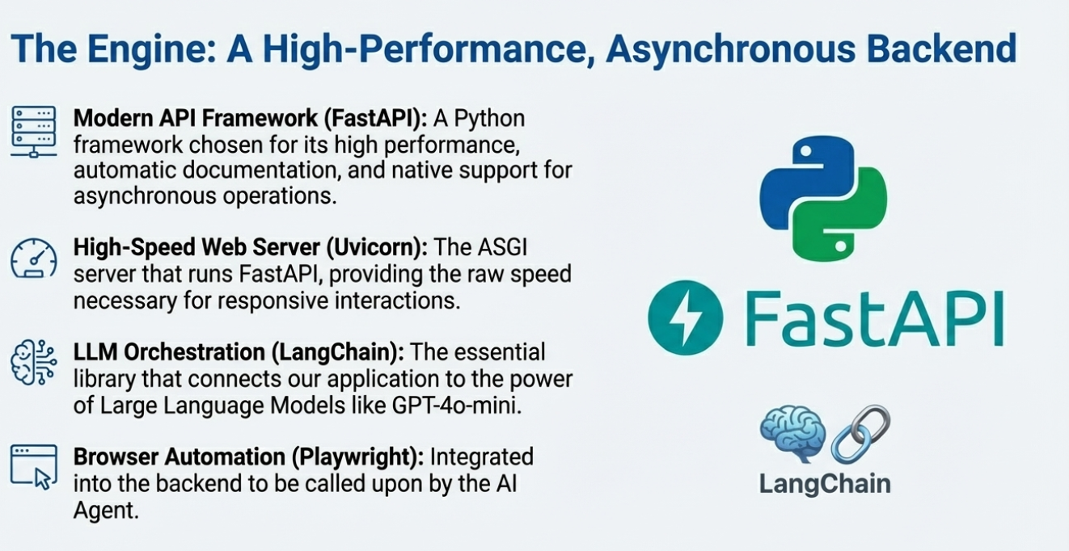

Slide 8

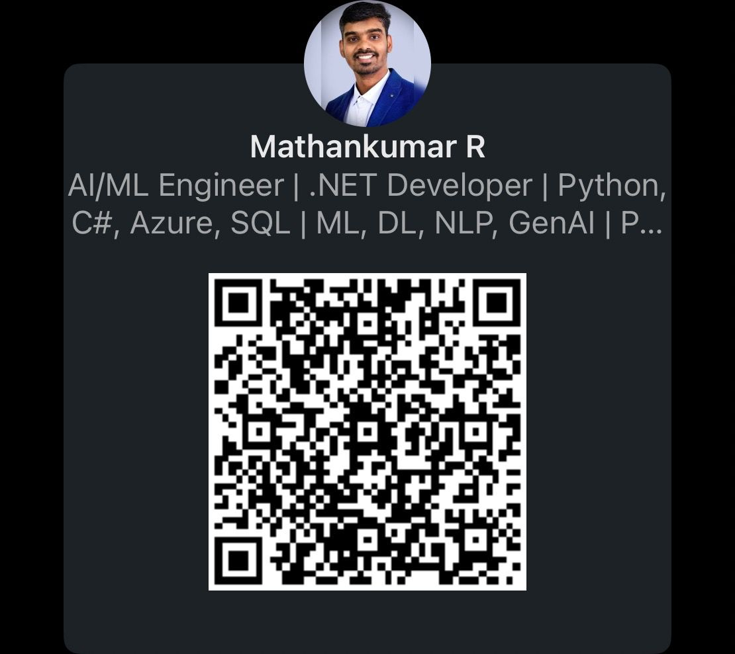
Thank You All

